Slide 1







MD. ZEHADUL ISLAM
ID: 222902069

Slide 2
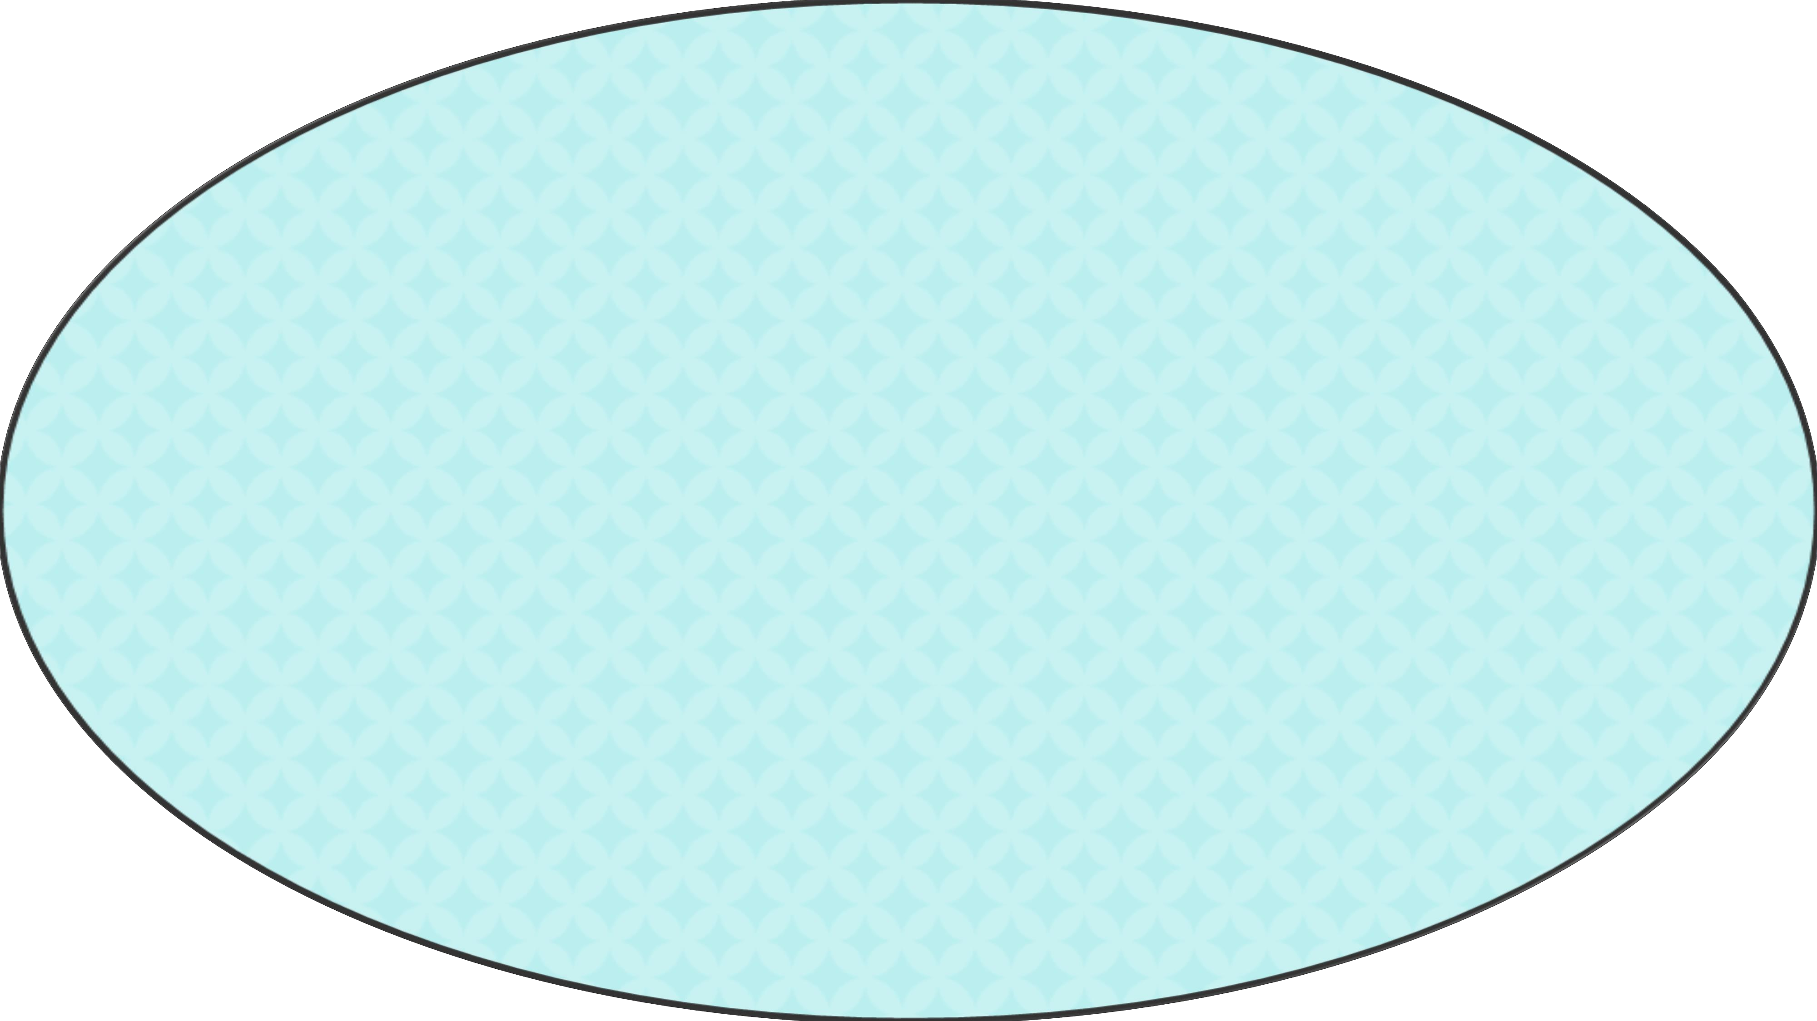
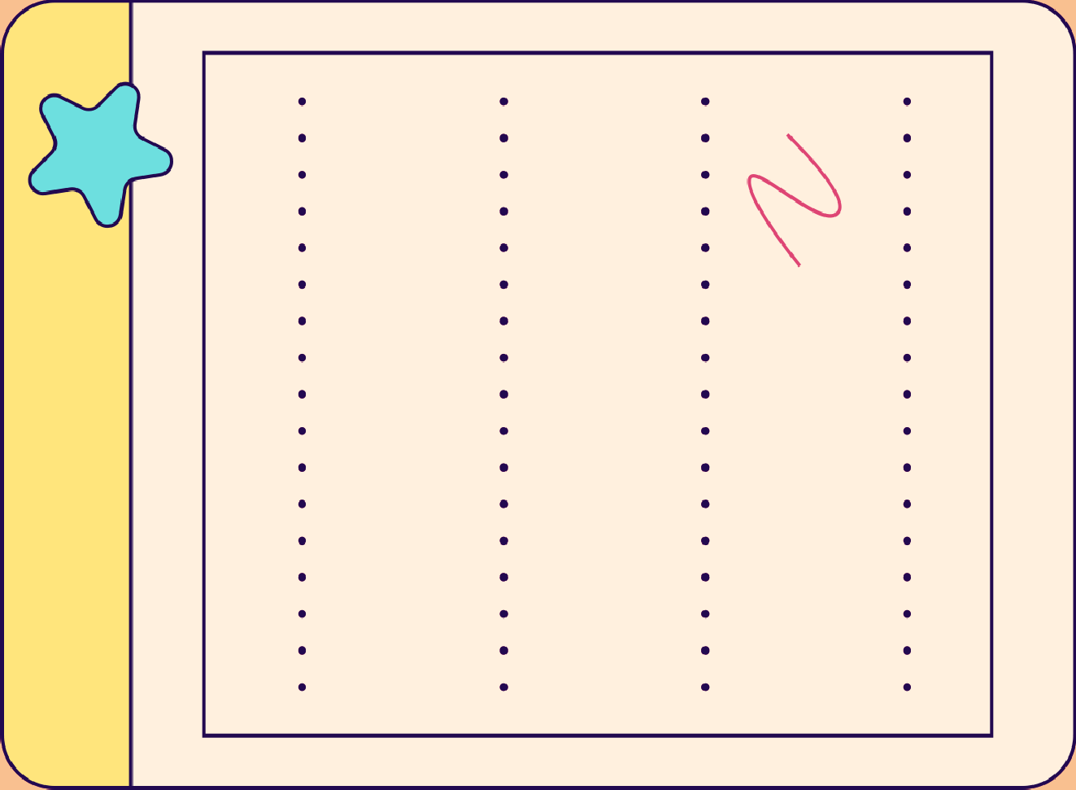











Quiz Game Defination
About Duiz Game

Slide 3





Testing identifies gaps in Knowledge
This quiz game develops and facilitates our learning.

Slide 4









Tools & Languages used in the Project

Slide 5




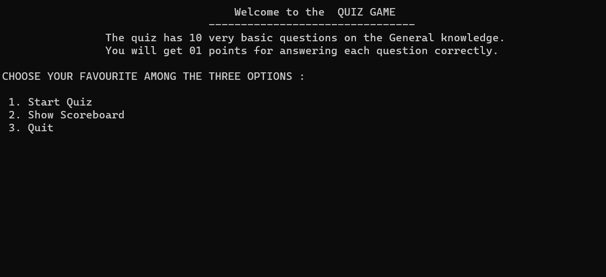


Are You Ready?
Implementation
1…..

Slide 6




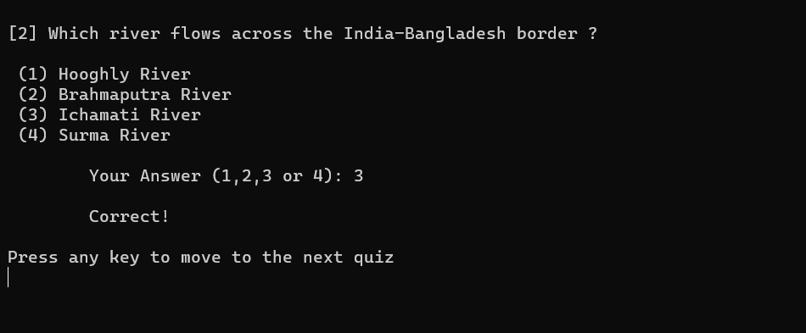
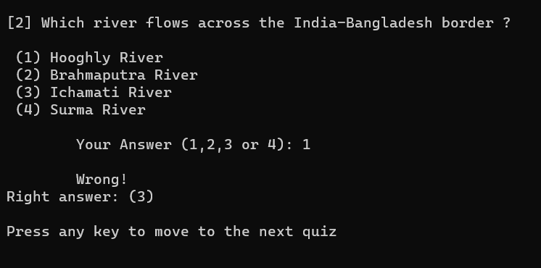


2.
3.

Slide 7


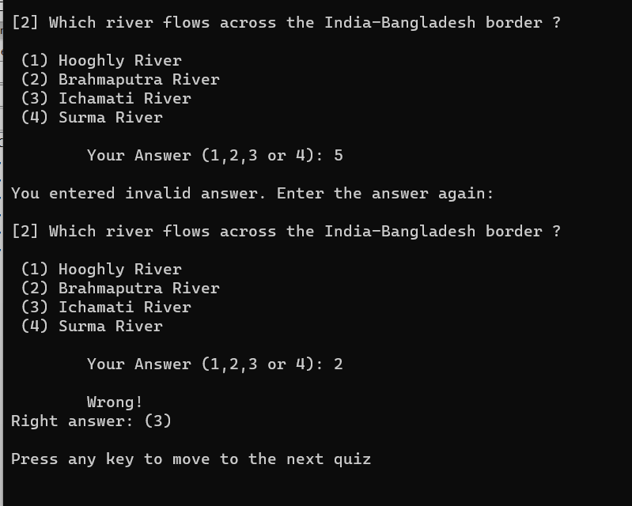



THE ANSWER IS...
4...

Slide 8






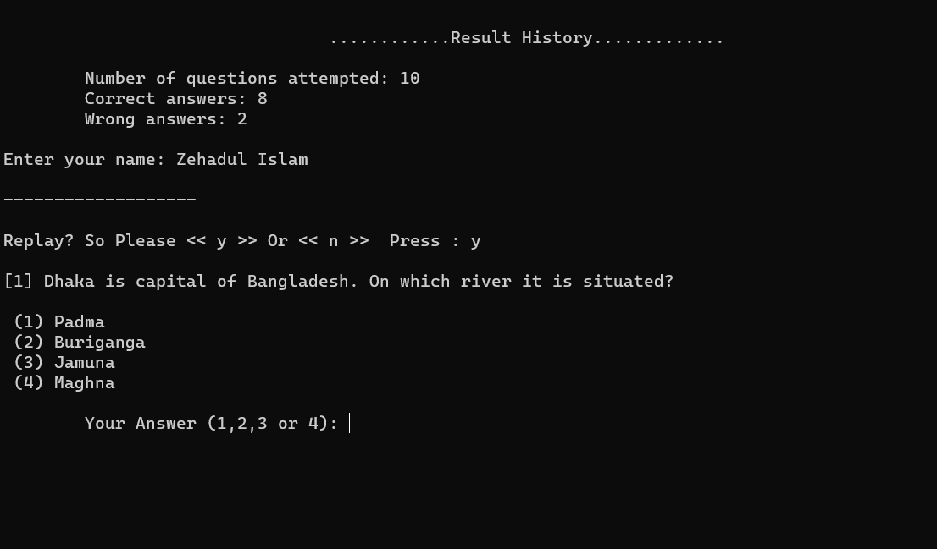






Your Result is .....
5…
(1)
(2)
(3)
(4)

Slide 9


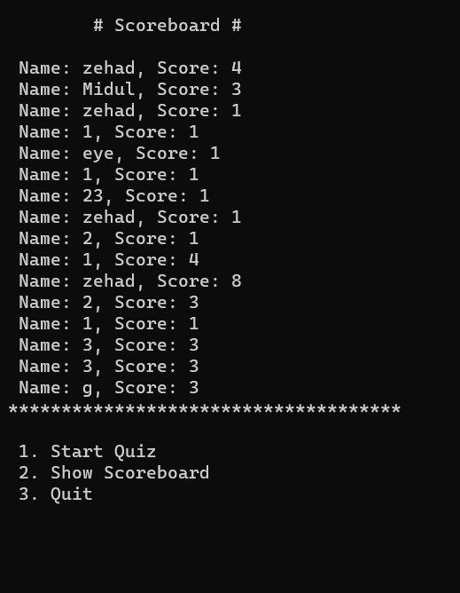



6….
7….
SCOREBOARD

Slide 10









Slide 11





Limitations :
I can add unlimited questions to this Quiz game.
Future Work :
I will develop the program in the future so that it shows different questions at different times..etc…

Slide 12




Everything has two sides (negative/positive).Above all we have made these games for fun and students will learn a lot in the process. We request everyone to take the game positively.

Slide 13





THANK YOU !

